Slide 1




Department 13
Litvinov Vladislav
SOME WORDS ABOUT
NEURAL NETWORKS
@Kordebalet
Kordebalet67
kordebalet67@gmail.com

Slide 2


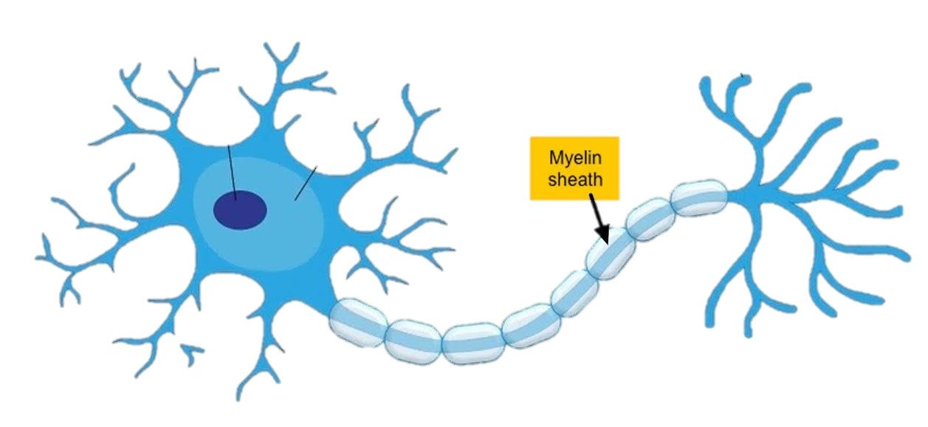
NEURAL NETWORKS
Our brain: ~100 billion neurons
Fruit flie’s brain: ~100000 neurons
Nematode’s brain: 302 neurons
WHAT NEURON IS?
Incoming signal
Threshold
Activation function
Answer
Neuron – base structural and functional unit of our brain
nucleos
soma
Axon terminals
dendrite
axon

Slide 3


ACTIVATION FUNCTION
WHAT ACTIVATION FUNCTION IS? AND WHAT FOR?
Function which gets incoming signal and generate output signal with accounting threshold value is called activation function
Step function
Answer between 0 and 1 in dependence of threshold
Sigmoid
Gradient step function (1/(1+e^{-x}))
ReLU
Zero for negative inputs and value of input for others

Slide 4
NEURON ARCITECTURE
NEURONS
To recreate biological neurons we’ll use the amount of all incoming values with multiply it on activation function if we talk about neurons from shadow layers.
Also neurons can be from input and output layers.
input a
inputs
amount
x =
a + b + c
input b
output y
activation func
y(x)
input c
www.reallygreatsite.com

Slide 5


NEURAL NETWORK
HOW TO RECREATE BIOLOGICAL NEURAL LINKS?
Each neuron gets data from all neurons from previous layer. To get output value from neuron we should summarize all input values and multiply them with activation function.
What is it:
1
1
1
inputs
outputs
2
2
2
3
3
3
w₁₁ w₂₁ w₃₁
w₁₂ w₂₂ w₃₂
w₁₃ w₂₃ w₃₃
layer 1
layer 2
layer 3

Slide 6

NEURAL NETWORKS
Some definitions
Mistake – difference between output value and correct answer.
Training NN – process of correction weights of all neurons.
The way to correct weights – is backpropagation of the error with help of transposed matrix of weights.
Weight correction during training
1/2 error?
3/4 error
1
w₁₁=3.0
1
output error
w₂₁=1.0
T
w₁₁ w₂₁ w₃₁
w₁₂ w₂₂ w₃₂
w₁₃ w₂₃ w₃₃
e₁₁
e₁₂
e₁₃
2
1/2 error?
1/4 error

Slide 7


NEURAL NETWORKS
Very good way to correct weights – the gradient descent method. This method is truly stable with defects of data and difficult functions. As we don’t want to lose minimum error we should use teaching ratio.
Error
image minimum
correct minimum
W_{ij}
The gradient descent method

Slide 8
NEURAL NETWORKS
DATA PREPARATION
Output values must be in range of (0:1) if we use logical sigmoid.
Initial values must be chosen carefully because of probability non-active neurons or extremely overweight neuron.
0.12 0.64 0.43
0.72 0.55 0.81
0.10 0.99 0.13
Initial values must be non-zero.
Most likely way to generate initial values - normal distribution of values of range of (-1.0; 1.0).
-1
0
1

Slide 9
Department 13
THANK YOU.
Litvinov Vladislav
kordebalet67@gmail.com
@Kordebalet
Kordebalet67

